Slide 1
Stages in the Research Process
The steps of the process are as follows
1. Defining the research objectives (What is to be done?)
2. Planning a research design ( How it to be done?)
3. Planning a sample ( From where will the data be taken or observed ?)
4. Collecting the data ( How the data will be collected?)
5. Analyzing the data ( Which analytical method will be chosen?)
6. Formulating the conclusions and preparing the report
The above sequence of activities are highly interrelated . The stages of the research process overlap continuously, and not necessarily follows exactly the same ordered sequence of activities

Slide 2
PROBLEM DEFINITION PROCESS

Slide 3
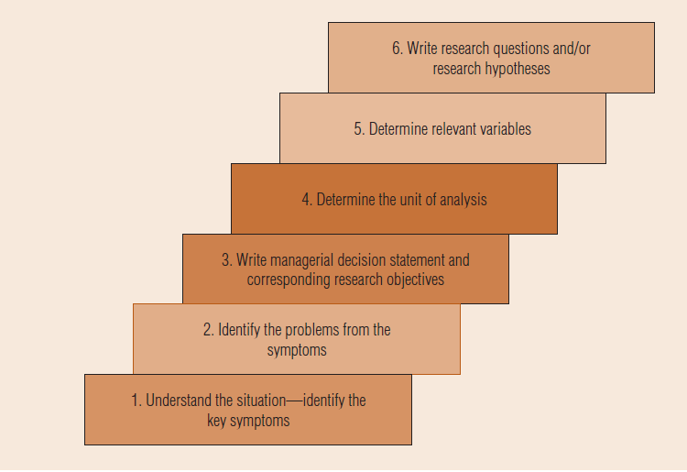
Important
The Problem-Definition Process

Slide 4
Signal/Symptoms of wellness
Signal /Symptoms of Disease
Immediate or expected change in the signal/symptom
External Change
Internal Change
If there is no control over the external change, various measures of internal change has to be suggested and then selected
Identify the internal changes and the reasons thereof . Restore the change to normal
There are many internal measures which are to be adopted to restore the change to normal. Selecting one of these is a managerial decision.

Slide 5
UNDERSTAND THE (SITUATION) BUSINESS DECISION
A situation analysis involves the gathering of background information to familiarize researchers and managers with the decision-making environment.
Gaining an awareness of the situation often requires exploratory research. Researchers sometimes apply qualitative research with the objective of better problem definition.
The situation analysis begins with an interview between the researcher and management.

Slide 6
IDENTIFYING THE RELEVANT ISSUES FROM THE SYMPTOMS
The preceding interview is extremely useful in translating the decision situation into a working problem definition by focusing on symptoms. The researcher needs to be doubly certain that the research attacks real problems and not superficial symptoms.
For instance, when a firm has a problem with advertising effectiveness, the possible causes of this problem may be low brand awareness, the wrong brand image, use of the wrong media, or perhaps too small a budget.
Certain occurrences that appear to be the problem may be only symptoms of a deeper problem.

Slide 7
How to trace the underlying cause for the symptom?
Interviews with key decision makers can be one of the best ways to identify key problem symptoms.
Once symptoms are identified, then the researcher must probe to identify possible causes of these changes.
One of the most important questions the researcher can ask during these interviews is, “what has changed?” Then, the researcher should probe to identify potential causes of the change.
It is important that the researcher repeat this process to make sure that some important change has not been left out.
In addition, the researcher should look for changes in company documents, including financial statements and operating reports. Changes may also be identified by tracking down news about competitors and customers.
In the change interview, the researcher is trying to identify possible changes in the customers, the competitors, the internal conditions of the company, and the external environment.

Slide 8
WRITING MANAGERIAL DECISION STATEMENTS AND CORRESPONDING RESEARCH OBJECTIVES
The situation analysis ends once researchers have a clear idea of the managerial objectives. Decision statements capture these objectives in a way that invites multiple solutions.
Multiple solutions are encouraged by using plural nouns to describe solutions.
Ultimately, research may provide evidence showing results of several ways a problem can be attacked.
Decision statements must be translated into research objectives. At this point, the researcher is starting to visualize what will need to be measured and what type of study will be needed.
Once the decision statement is written, the research essentially answers the question, “What information is needed to address this situation?”

Slide 9
The researcher should reach a consensus agreement with the decision maker regarding the overall decision statement(s) and research objectives. If the decision maker agrees that the statement captures the situation well and understands how the research objectives, if accomplished, will help address the situation, then the researcher can proceed.
The researcher should make every effort to ensure that the decision maker understands what a research project can deliver. If there is no agreement on the decision statement or research objectives, more dialogue between decision makers and researchers is needed.

Slide 10
DETERMINE THE UNIT OF ANALYSIS
The unit of analysis for a study indicates what or who should provide the data and at what level of aggregation.
Researchers specify whether an investigation will collect data about individuals (such as customers, employees, and owners), households (families, extended families, and so forth), organizations (businesses and business units), departments (sales, finance, and so forth), geographical areas, or objects (products, advertisements, and so forth).
In studies of home buying, for example, the husband/wife dyad typically is the unit of analysis rather than the individual because many purchase decisions are made jointly by husband and wife.
Researchers who think carefully and creatively about situations often discover that a problem can be investigated at more than one level of analysis.
For example, a lack of worker productivity could be due to problems that face individual employees or it could reflect problems that are present in entire business units. Determining the unit of analysis should not be overlooked during the problem-definition stage of the research.

Slide 11
WRITE RESEARCH OBJECTIVES AND QUESTIONS
Research questions express the research objectives in terms of questions that can be addressed by research.
Hypotheses are more specific than research questions. One key distinction between research questions and hypotheses is that hypotheses can generally specify the direction of a relationship. In other words, when an independent variable goes up, we have sufficient knowledge to predict that the dependent variable should also go up/down.
At times, a researcher may suspect that two variables are related but have insufficient theoretical rationale to support the relationship as positive or negative. In this case, hypotheses cannot be offered.
At times in research, particularly in exploratory research, a proposal can only offer research questions. Research hypotheses are much more specific and therefore require considerably more theoretical support. In addition, research questions are interrogative, whereas research hypotheses are declarative.

Slide 12
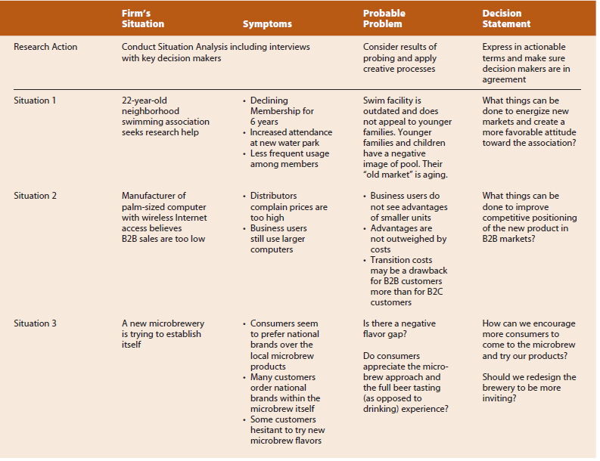

Slide 13
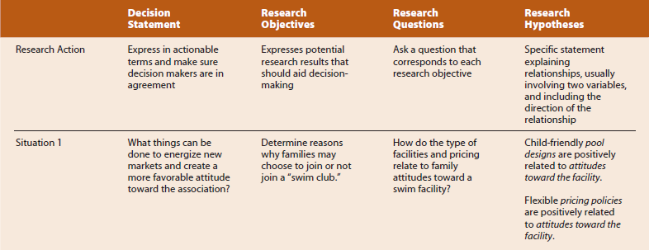

Slide 14
THANK YOU

Slide 15
Marketing
HR
Finance
Less Job in the market
Grooming
Students not upto the mark
Listening
Low Placement
Faculty not upto the mark
Soft skill
Speaking
Poor infrastructure
Technical skill
Confidence
Low Enrolment
Not great canteen
No college Life
Class rooms
Technical/content
Auditorium
Delivery issues
Crowd
Lounges
No practical experience
Activities
Computers

